Slide 1
Computer Architecture
A Quantitative Approach, Sixth Edition
Chapter 5
Thread-Level Parallelism
We are dedicating all of our future product development to multicore designs. We believe this is a key inflection point for the industry--Paul Otellini, President, Intel, 2005

Slide 2
Introduction
Introduction
Thread-Level parallelism
Have multiple program counters
Uses MIMD model
Targeted for tightly-coupled shared-memory multiprocessors
For n processors, need n threads
Amount of computation assigned to each thread = grain size
Threads can be used for data-level parallelism, but the overheads may outweigh the benefit

Slide 3
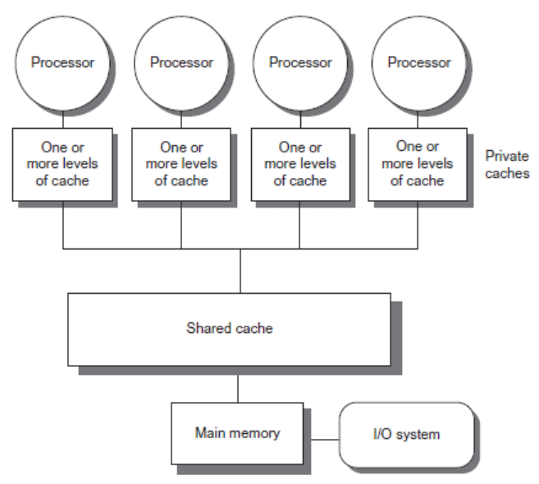
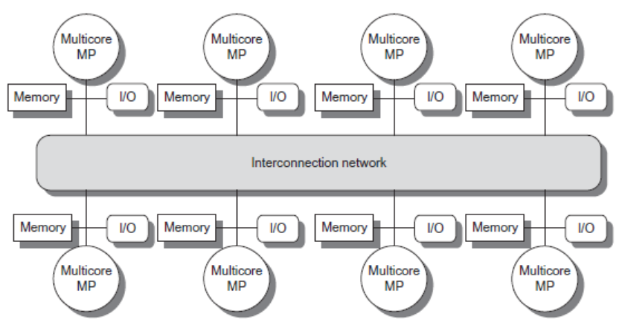
Types
Introduction
Symmetric multiprocessors (SMP)
Small number of cores
Share single memory with uniform memory latency
Distributed shared memory (DSM)
Memory distributed among processors
Non-uniform memory access/latency (NUMA)
Processors connected via direct (switched) and non-direct (multi-hop) interconnection networks

Slide 4
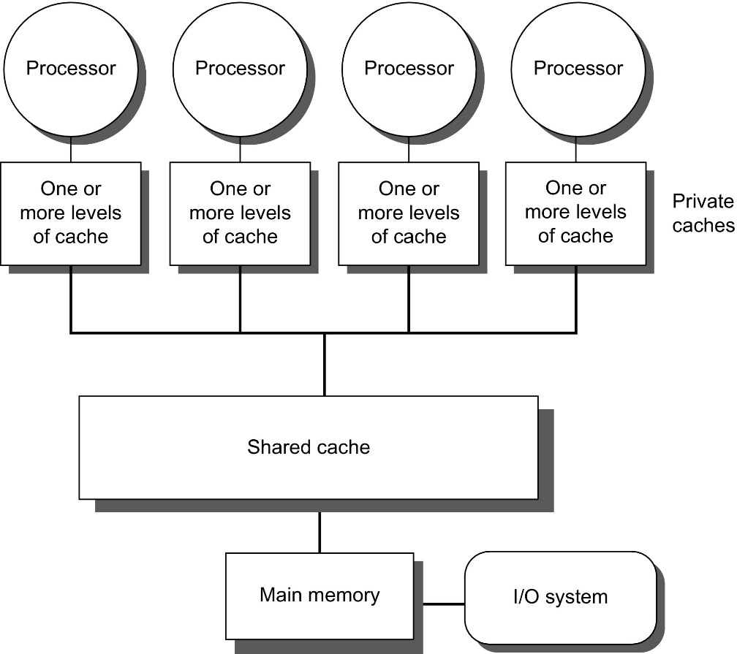
Figure 5.1 Basic structure of a centralized shared-memory multiprocessor based on a multicore chip.
Multiple processor-cache subsystems share the same physical memory, typically with one level of shared cache on the multicore, and one or more levels of private per-core cache. The key architectural property is the uniform access time to all of the memory from all of the processors. In a multichip design, an interconnection network links the processors and the memory, which may be one or more banks. In a single-chip multicore, the interconnection network is simply the memory bus.

Slide 5
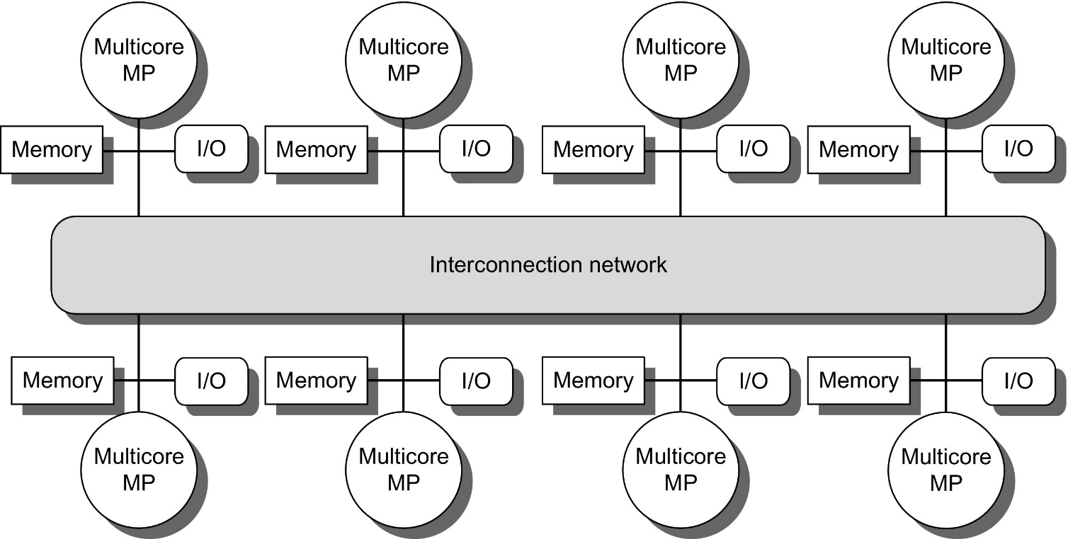
Figure 5.2 The basic architecture of a distributed-memory multiprocessor in 2017 typically consists of a multicore multiprocessor chip with memory and possibly I/O attached and an interface to an interconnection network that connects all the nodes. Each processor core shares the entire memory, although the access time to the local memory attached to the core's chip will be much faster than the access time to remote memories.

Slide 6
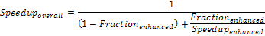
Principles of Computer Design
Principles
Take Advantage of Parallelism
e.g. multiple processors, disks, memory banks, pipelining, multiple functional units
Principle of Locality
Reuse of data and instructions
Focus on the Common Case
Amdahl’s Law

Slide 7
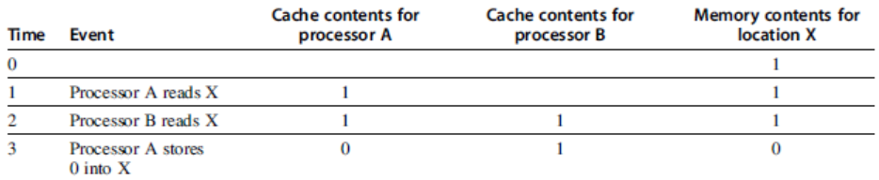
Cache Coherence
Processors may see different values through their caches:
Centralized Shared-Memory Architectures

Slide 8
Cache Coherence
Coherence
All reads by any processor must return the most recently written value
Writes to the same location by any two processors are seen in the same order by all processors
Consistency
When a written value will be returned by a read
If a processor writes location A followed by location B, any processor that sees the new value of B must also see the new value of A
Centralized Shared-Memory Architectures

Slide 9
Enforcing Coherence
Coherent caches provide:
Migration: movement of data
Replication: multiple copies of data
Cache coherence protocols
Directory based
Sharing status of each block kept in one location
Snooping
Each core tracks sharing status of each block
Centralized Shared-Memory Architectures

Slide 10
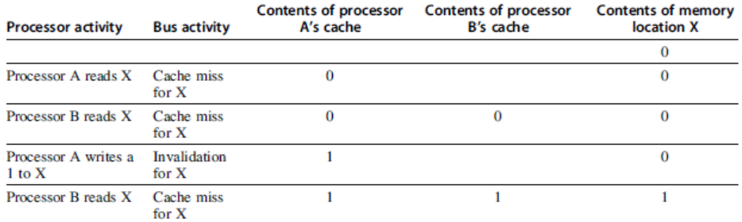
Snoopy Coherence Protocols
Write invalidate
On write, invalidate all other copies
Use bus itself to serialize
Write cannot complete until bus access is obtained
Write update
On write, update all copies
Centralized Shared-Memory Architectures

Slide 11
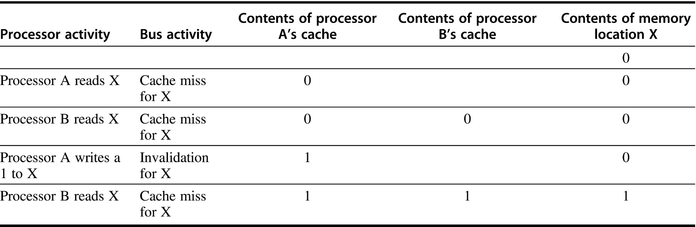
Figure 5.4 An example of an invalidation protocol working on a snooping bus for a single cache block (X) with write-back caches. We assume that neither cache initially holds X and that the value of X in memory is 0. The processor and memory contents show the value after the processor and bus activity have both completed. A blank indicates no activity or no copy cached. When the second miss by B occurs, processor A responds with the value canceling the response from memory. In addition, both the contents of B's cache and the memory contents of X are updated. This update of memory, which occurs when a block becomes shared, simplifies the protocol, but it is possible to track the ownership and force the write-back only if the block is replaced. This requires the introduction of an additional status bit indicating ownership of a block. The ownership bit indicates that a block may be shared for reads, but only the owning processor can write the block, and that processor is responsible for updating any other processors and memory when it changes the block or replaces it. If a multicore uses a shared cache (e.g., L3), then all memory is seen through the shared cache; L3 acts like the memory in this example, and coherency must be handled for the private L1 and L2 caches for each core. It is this observation that led some designers to opt for a directory protocol within the multicore. To make this work, the L3 cache must be inclusive; recall from Chapter 2, that a cache is inclusive if any location in a higher level cache (L1 and L2 in this case) is also in L3. We return to the topic of inclusion on page 423.

Slide 12
Snoopy Coherence Protocols
Locating an item when a read miss occurs
In write-back cache, the updated value must be sent to the requesting processor
Cache lines marked as shared or exclusive/modified
Only writes to shared lines need an invalidate broadcast
After this, the line is marked as exclusive
Centralized Shared-Memory Architectures

Slide 13
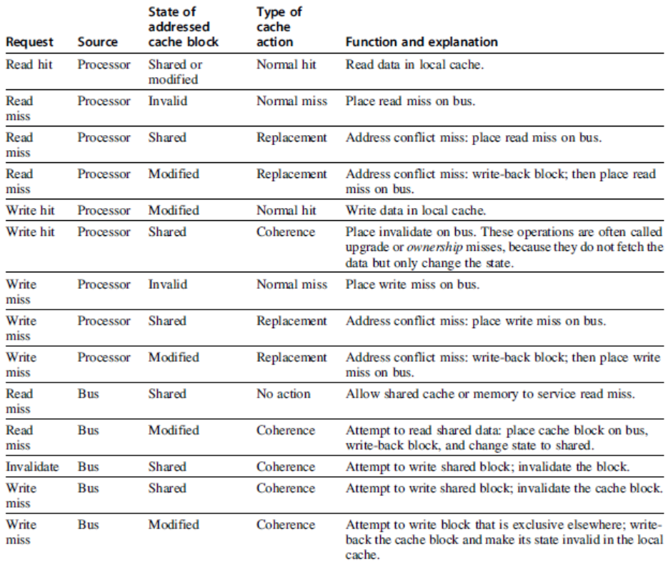
Snoopy Coherence Protocols
Centralized Shared-Memory Architectures

Slide 14
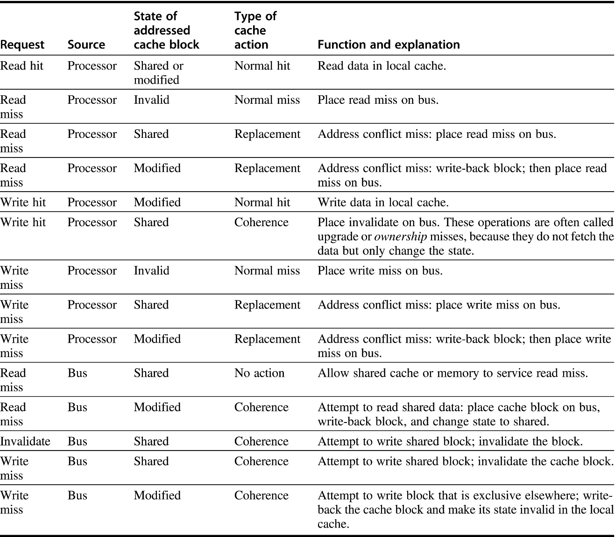
Figure 5.5 The cache coherence mechanism receives requests from both the core's processor and the shared bus and responds to these based on the type of request, whether it hits or misses in the local cache, and the state of the local cache block specified in the request. The fourth column describes the type of cache action as normal hit or miss (the same as a uniprocessor cache would see), replacement (a uniprocessor cache replacement miss), or coherence (required to maintain cache coherence); a normal or replacement action may cause a coherence action depending on the state of the block in other caches. For read, misses, write misses, or invalidates snooped from the bus, an action is required only if the read or write addresses match a block in the local cache and the block is valid.

Slide 15
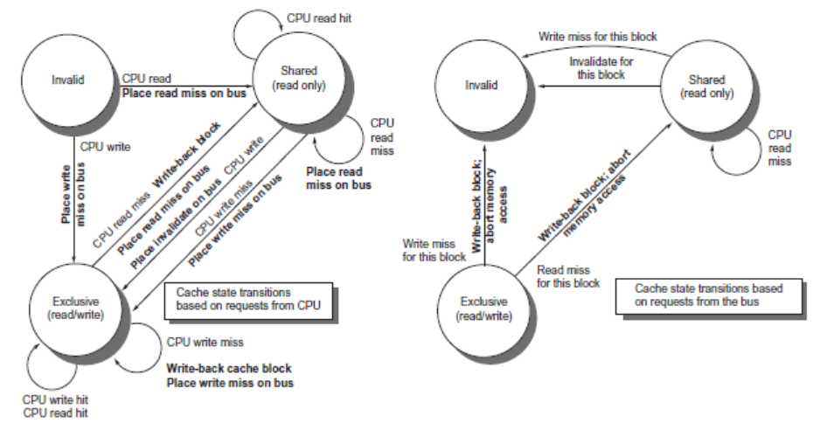
Snoopy Coherence Protocols
Centralized Shared-Memory Architectures

Slide 16
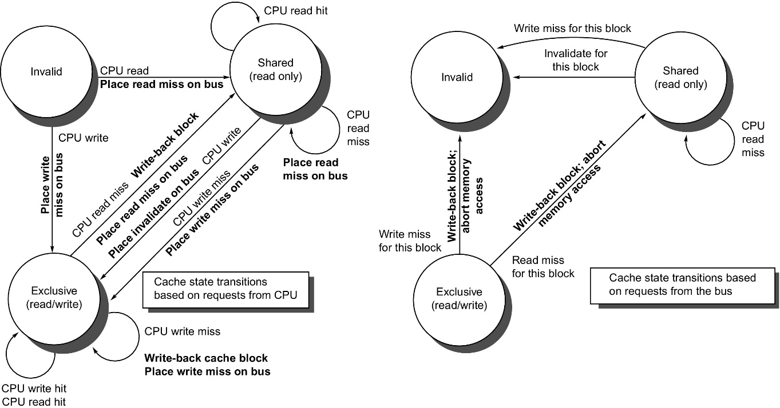
Figure 5.6 A write invalidate, cache coherence protocol for a private write-back cache showing the states and state transitions for each block in the cache. The cache states are shown in circles, with any access permitted by the local processor without a state transition shown in parentheses under the name of the state. The stimulus causing a state change is shown on the transition arcs in regular type, and any bus actions generated as part of the state transition are shown on the transition arc in bold. The stimulus actions apply to a block in the private cache, not to a specific address in the cache. Thus a read miss to a block in the shared state is a miss for that cache block but for a different address. The left side of the diagram shows state transitions based on actions of the processor associated with this cache; the right side shows transitions based on operations on the bus. A read miss in the exclusive or shared state and a write miss in the exclusive state occur when the address requested by the processor does not match the address in the local cache block. Such a miss is a standard cache replacement miss. An attempt to write a block in the shared state generates an invalidate. Whenever a bus transaction occurs, all private caches that contain the cache block specified in the bus transaction take the action dictated by the right half of the diagram. The protocol assumes that memory (or a shared cache) provides data on a read miss for a block that is clean in all local caches. In actual implementations, these two sets of state diagrams are combined. In practice, there are many subtle variations on invalidate protocols, including the introduction of the exclusive unmodified state, as to whether a processor or memory provides data on a miss. In a multicore chip, the shared cache (usually L3, but sometimes L2) acts as the equivalent of memory, and the bus is the bus between the private caches of each core and the shared cache, which in turn interfaces to the memory.

Slide 17
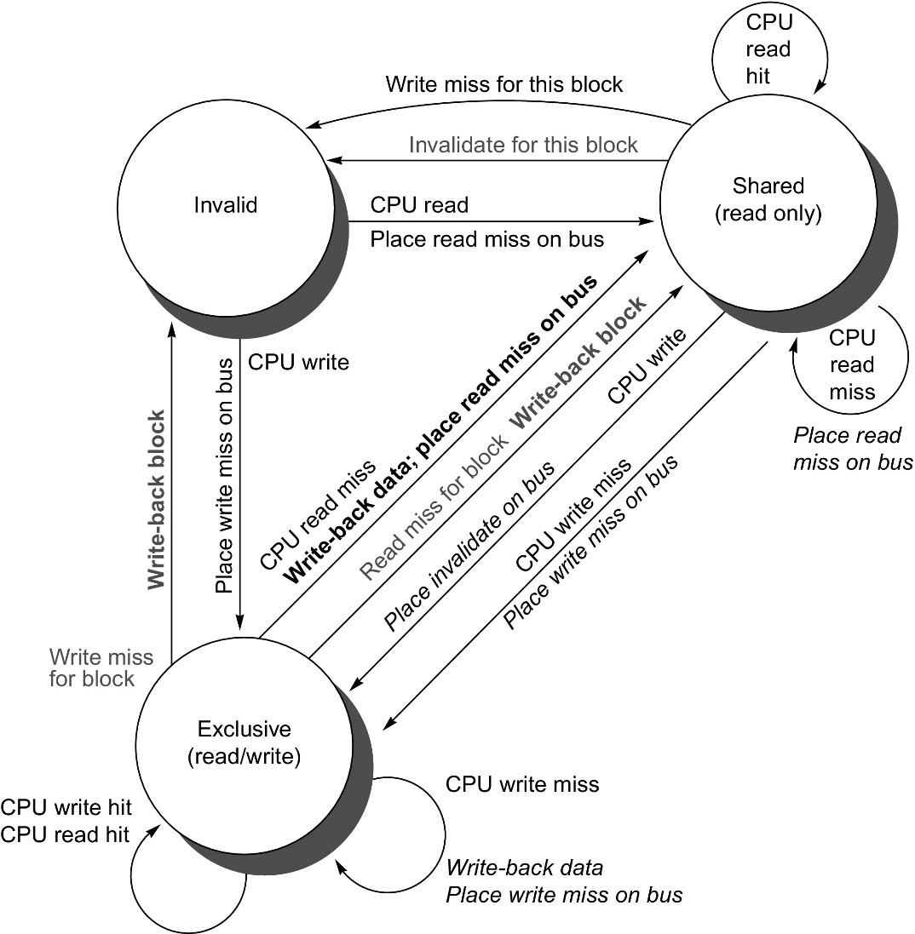
Figure 5.7 Cache coherence state diagram with the state transitions induced by the local processor shown in black and by the bus activities shown in gray. As in Figure 5.6, the activities on a transition are shown in bold.

Slide 18
Snoopy Coherence Protocols
Complications for the basic MSI ModifiedSharedInvalid protocol:
Operations are not atomic
E.g. detect miss, acquire bus, receive a response
Creates possibility of deadlock and races
One solution: processor that sends invalidate can hold bus until other processors receive the invalidate
Extensions:
Add exclusive state to indicate clean block in only one cache (MESI protocol) Adds Exclusive state (reduce traffic if block is needed by only one cache) – One of several refinements.
Prevents needing to write invalidate on a write
Owned state
Centralized Shared-Memory Architectures

Slide 19
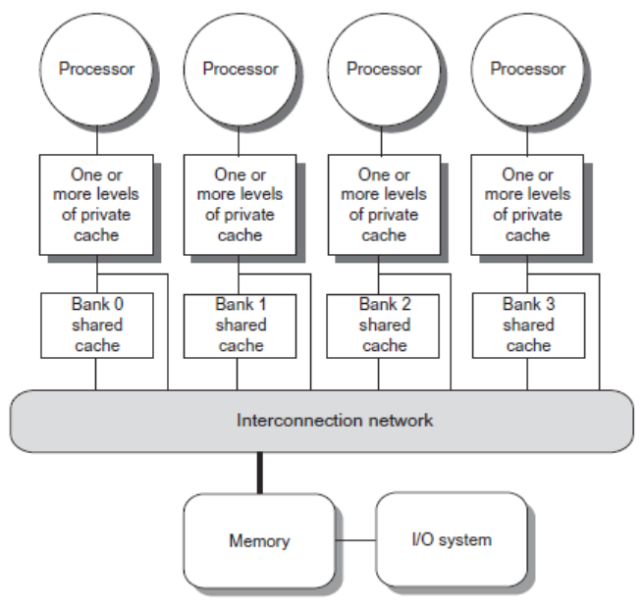
Coherence Protocols: Extensions
Shared memory bus and snooping bandwidth is bottleneck for scaling symmetric multiprocessors
Duplicating tags
Place directory in outermost cache
Use crossbars or point-to-point networks with banked memory
Centralized Shared-Memory Architectures

Slide 20
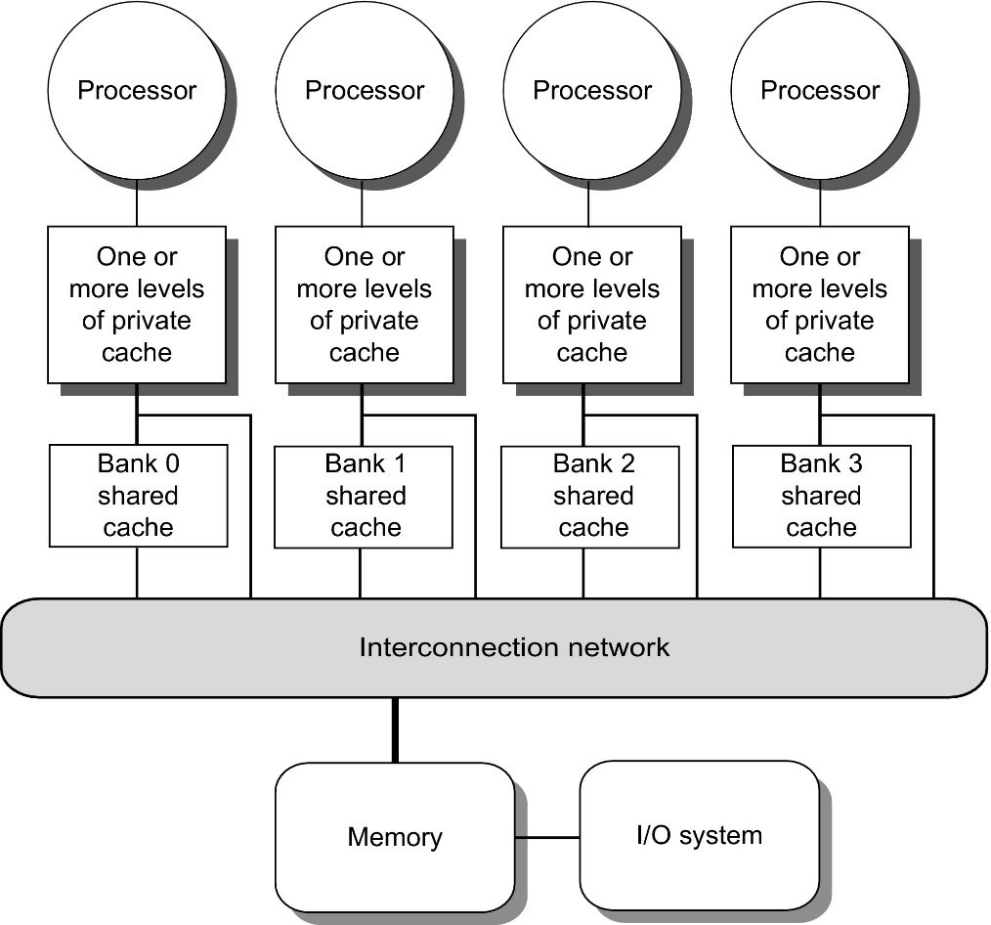
Figure 5.8 A single-chip multicore with a distributed cache. In current designs, the distributed shared cache is usually L3, and levels L1 and L2 are private. There are typically multiple memory channels (2–8 in today's designs). This design is NUCacheA, since the access time to L3 portions varies with faster access time for the directly attached core. Because it is NUCA, it is also NUMA.

Slide 21
Coherence Protocols
Every multicore with >8 processors uses an interconnect other than bus
Makes it difficult to serialize events
Write and upgrade misses are not atomic
How can the processor know when all invalidates are complete?
How can we resolve races when two processors write at the same time?
Solution: associate each block with a single bus
Centralized Shared-Memory Architectures

Slide 22
Performance
Coherence influences cache miss rate
Coherence misses
True sharing misses
Write to shared block (transmission of invalidation)
Read an invalidated block
False sharing misses
Read an unmodified word in an invalidated block
Performance of Symmetric Shared-Memory Multiprocessors

Slide 23
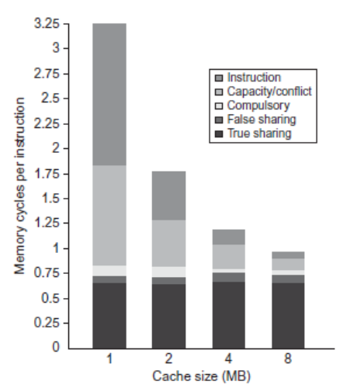
Performance Study: Commercial Workload
Performance of Symmetric Shared-Memory Multiprocessors

Slide 24
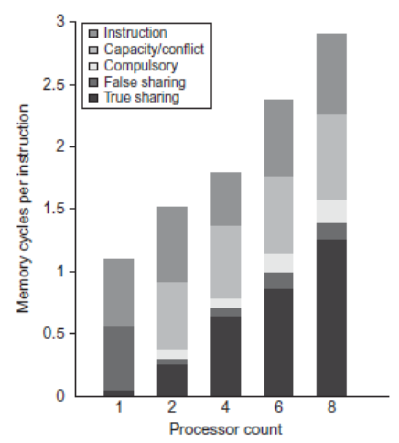
Performance Study: Commercial Workload
Performance of Symmetric Shared-Memory Multiprocessors

Slide 25
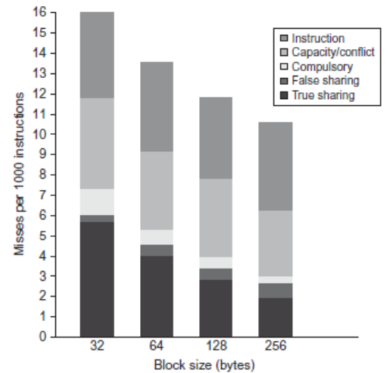
Performance Study: Commercial Workload
Performance of Symmetric Shared-Memory Multiprocessors

Slide 26
Directory Protocols
Snooping schemes require communication among all caches on every cache miss
Limits scalability
Another approach: Use centralized directory to keep track of every block
Which caches have each block
Dirty status of each block
Implement in shared L3 cache
Keep bit vector of size = # cores for each block in L3
Not scalable beyond shared L3
Distributed Shared Memory and Directory-Based Coherence

Slide 27
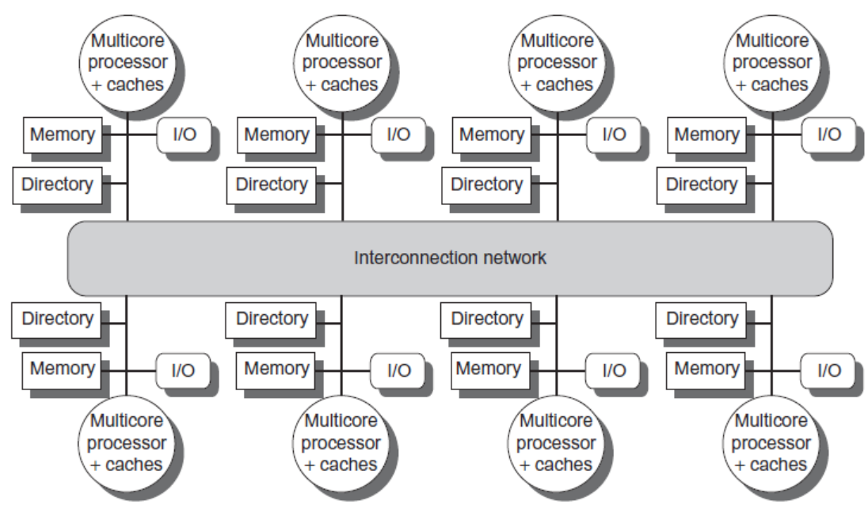
Directory Protocols
Alternative approach:
Distribute memory
Distributed Shared Memory and Directory-Based Coherence

Slide 28
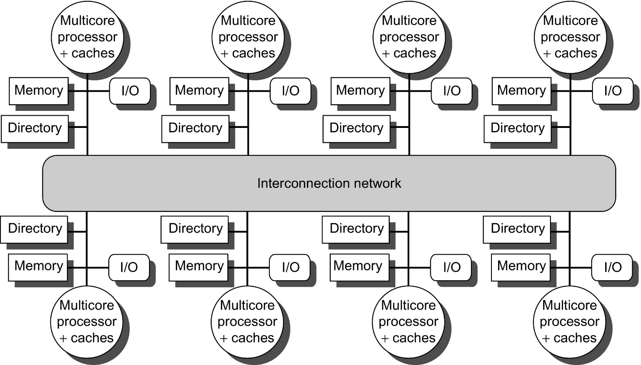
Figure 5.18 A directory is added to each node to implement cache coherence in a distributed-memory multiprocessor. In this case, a node is shown as a single multicore chip, and the directory information for the associated memory may reside either on or off the multicore. Each directory is responsible for tracking the caches that share the memory addresses of the portion of memory in the node. The coherence mechanism will handle both the maintenance of the directory information and any coherence actions needed within the multicore node.

Slide 29
Directory Protocols
For each block, maintain state:
Shared
One or more nodes have the block cached, value in memory is up-to-date
Set of node IDs
Uncached
Modified
Exactly one node has a copy of the cache block, value in memory is out-of-date
Owner node ID
Directory maintains block states and sends invalidation messages
Distributed Shared Memory and Directory-Based Coherence

Slide 30
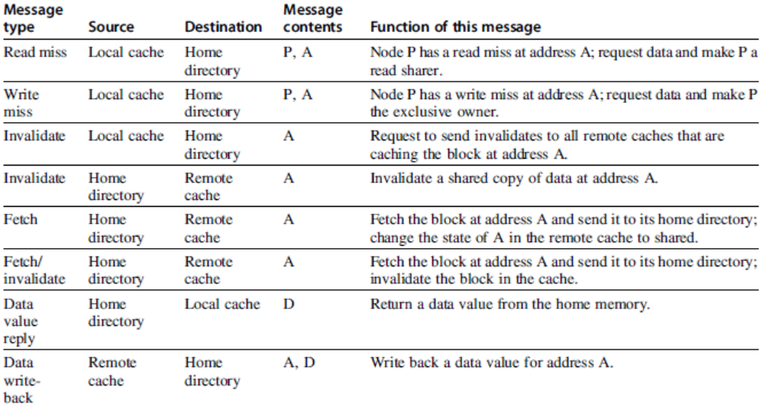
Messages
Distributed Shared Memory and Directory-Based Coherence

Slide 31
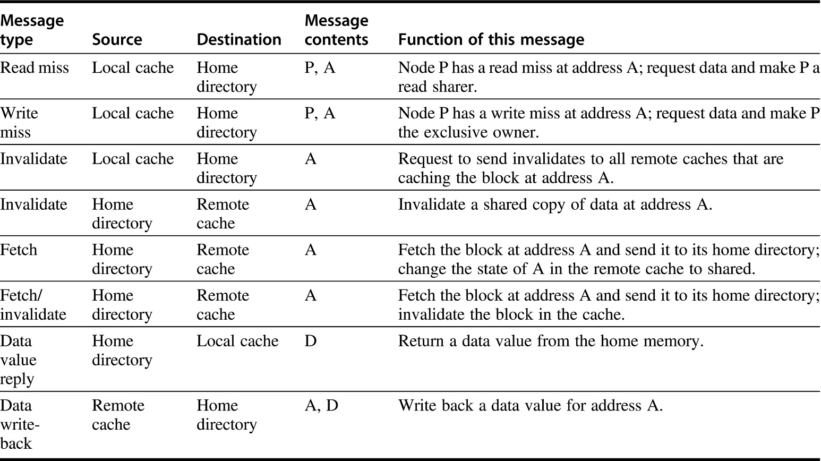
Figure 5.19 The possible messages sent among nodes to maintain coherence, along with the source and destination node, the contents (where P = requesting node number, A = requested address, and D = data contents), and the function of the message. The first three messages are requests sent by the local node to the home. The fourth through sixth messages are messages sent to a remote node by the home when the home needs the data to satisfy a read or write miss request. Data value replies are used to send a value from the home node back to the requesting node. Data value write-backs occur for two reasons: when a block is replaced in a cache and must be written back to its home memory, and also in reply to fetch or fetch/invalidate messages from the home. Writing back the data value whenever the block becomes shared simplifies the number of states in the protocol because any dirty block must be exclusive and any shared block is always available in the home memory.

Slide 32
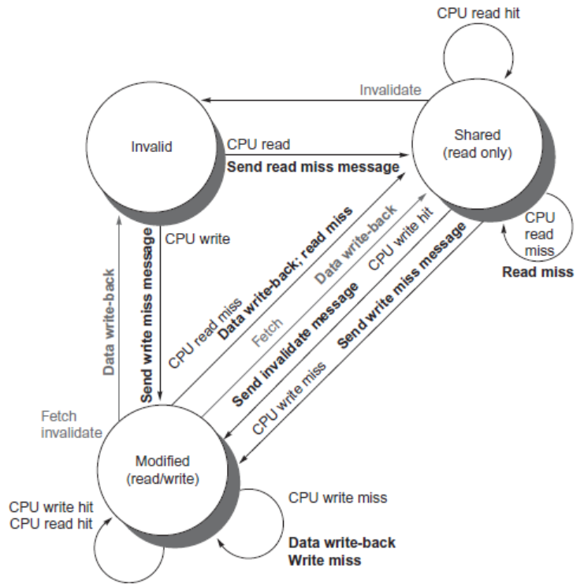
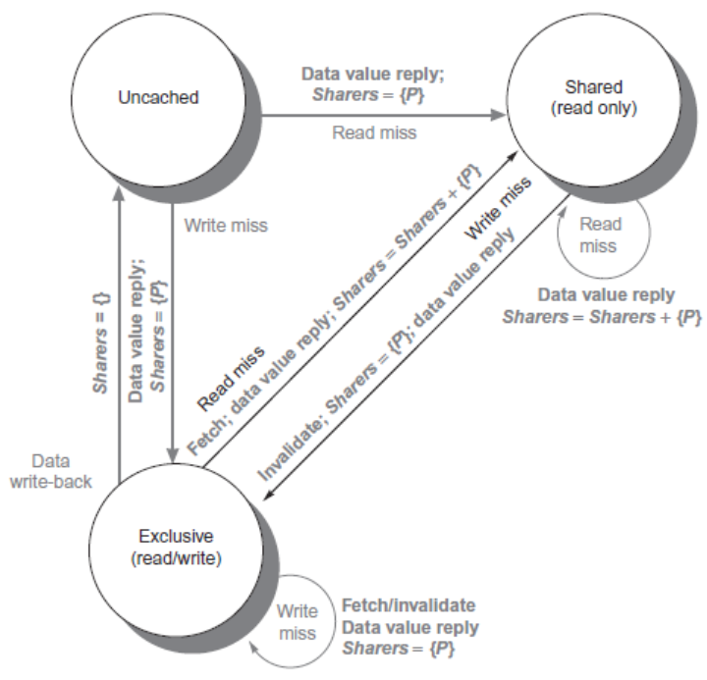
Directory Protocols
Distributed Shared Memory and Directory-Based Coherence

